Slide 1
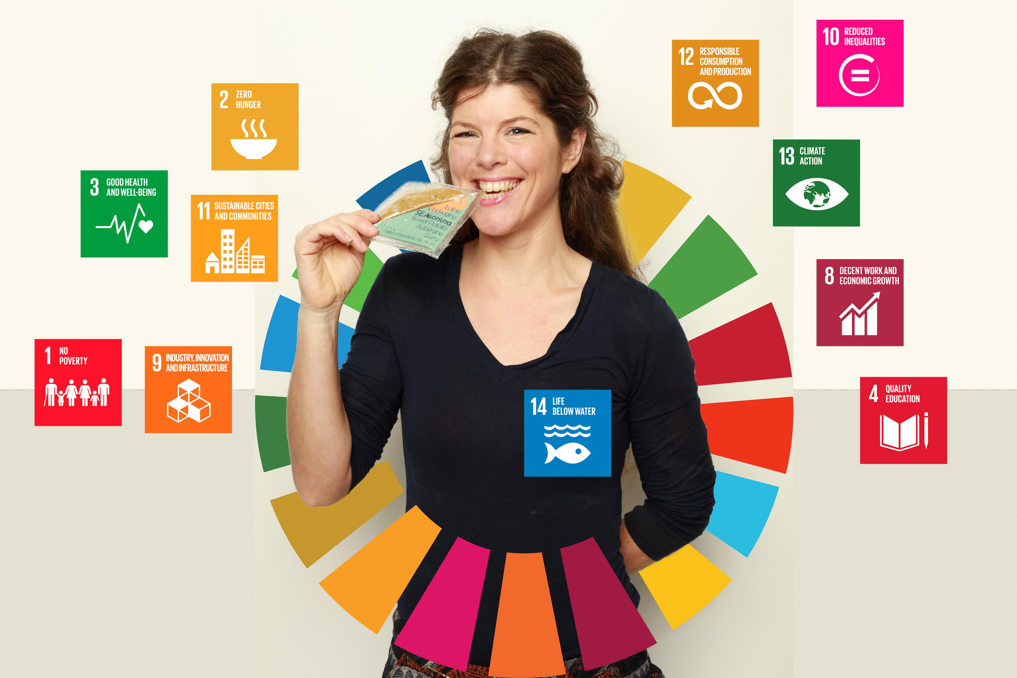
SEAsoning

Slide 2
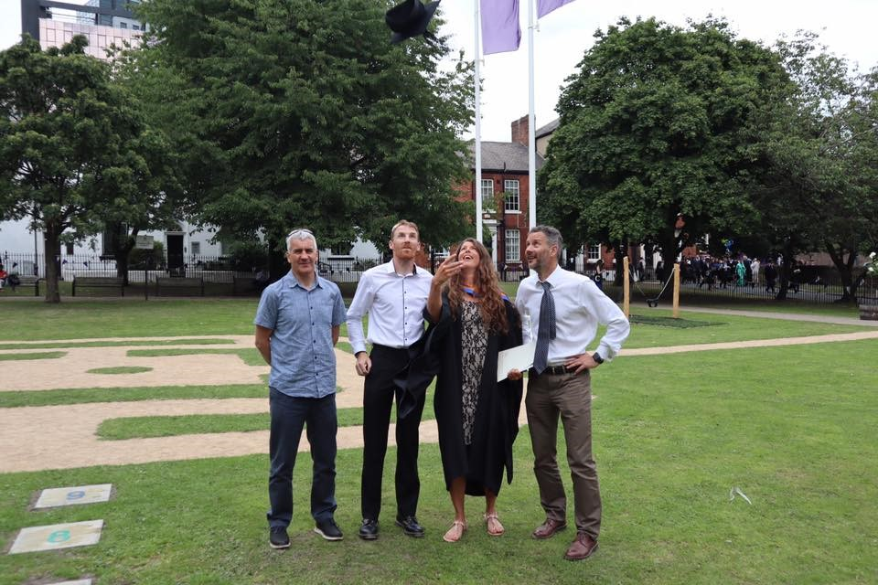
Graduation Day

Slide 3
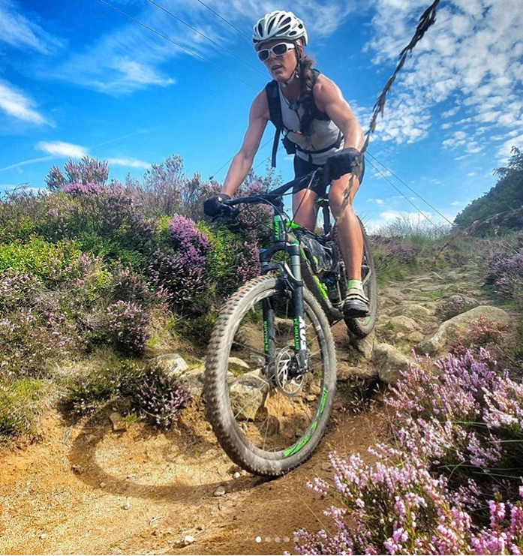
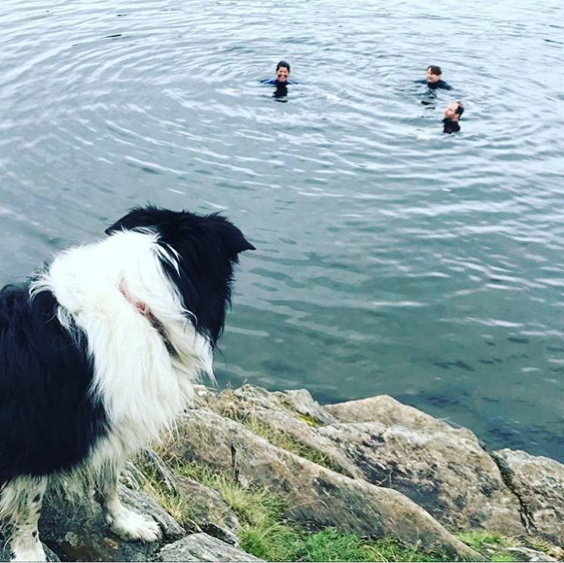
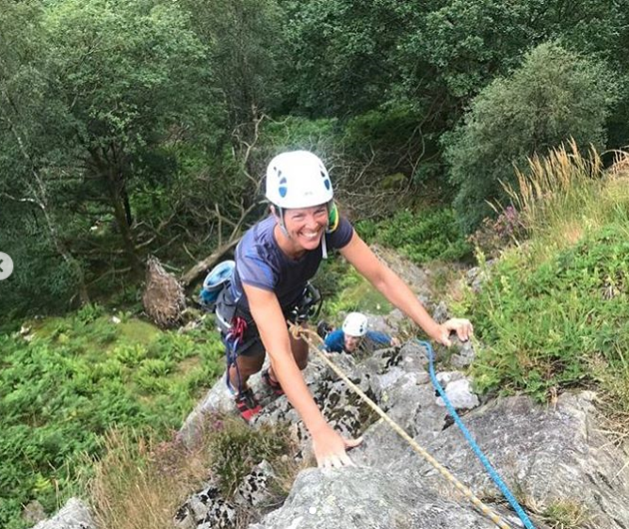
Love the Outdoors - Hate Litter

Slide 4
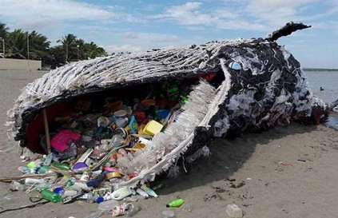
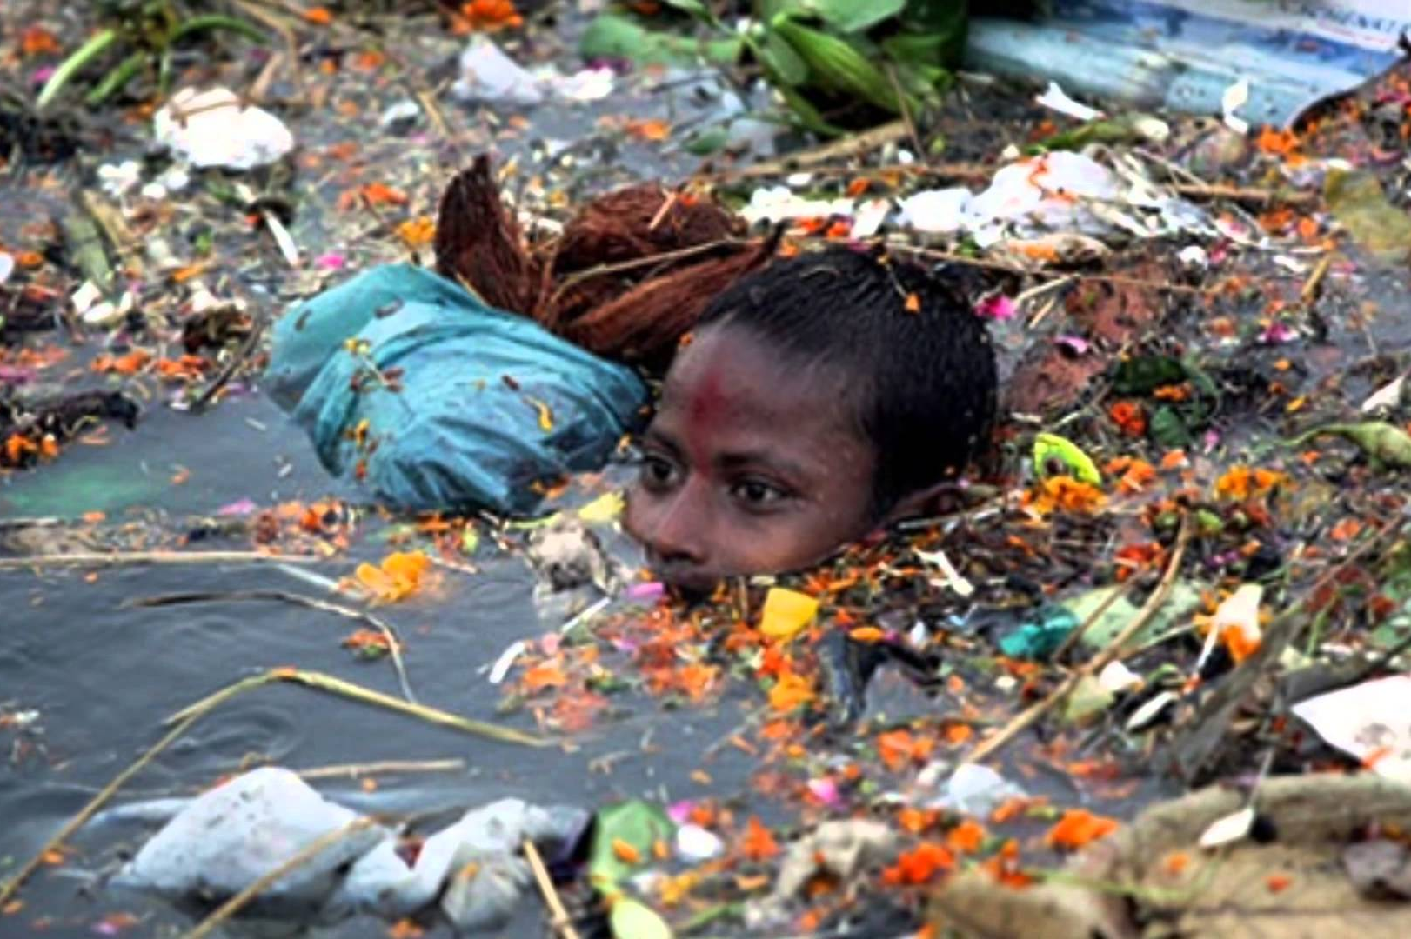
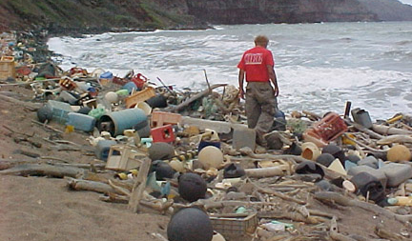
This Photo by Unknown Author is licensed under CC BY-NC-ND
Global Littering
This Photo by Unknown Author is licensed under CC BY-NC-ND
This Photo by Unknown Author is licensed under CC BY-SA

Slide 5
David Attenborough
“No one will protect what they don't care about;
and no one will care about what they have never experienced”
SEAsoning – Making good choices
Leave no Trace packaging solution

Slide 6
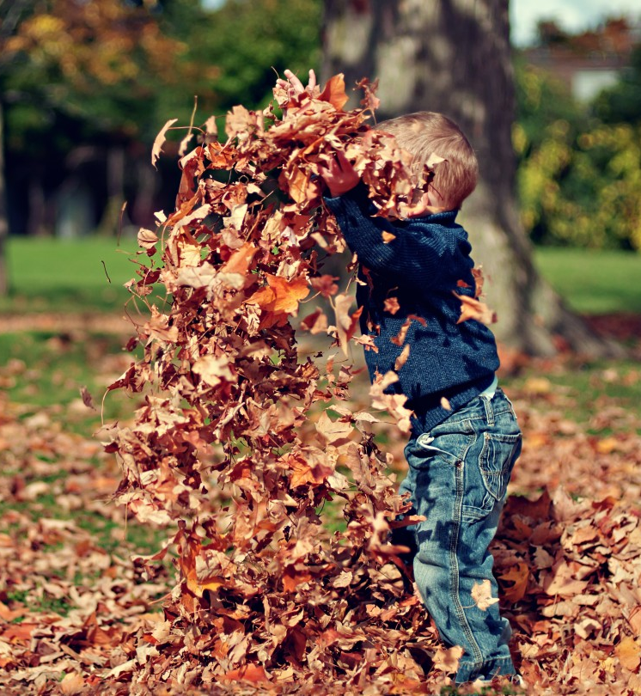
Making good choices
This Photo by Unknown Author is licensed under CC BY-NC-ND

Slide 7
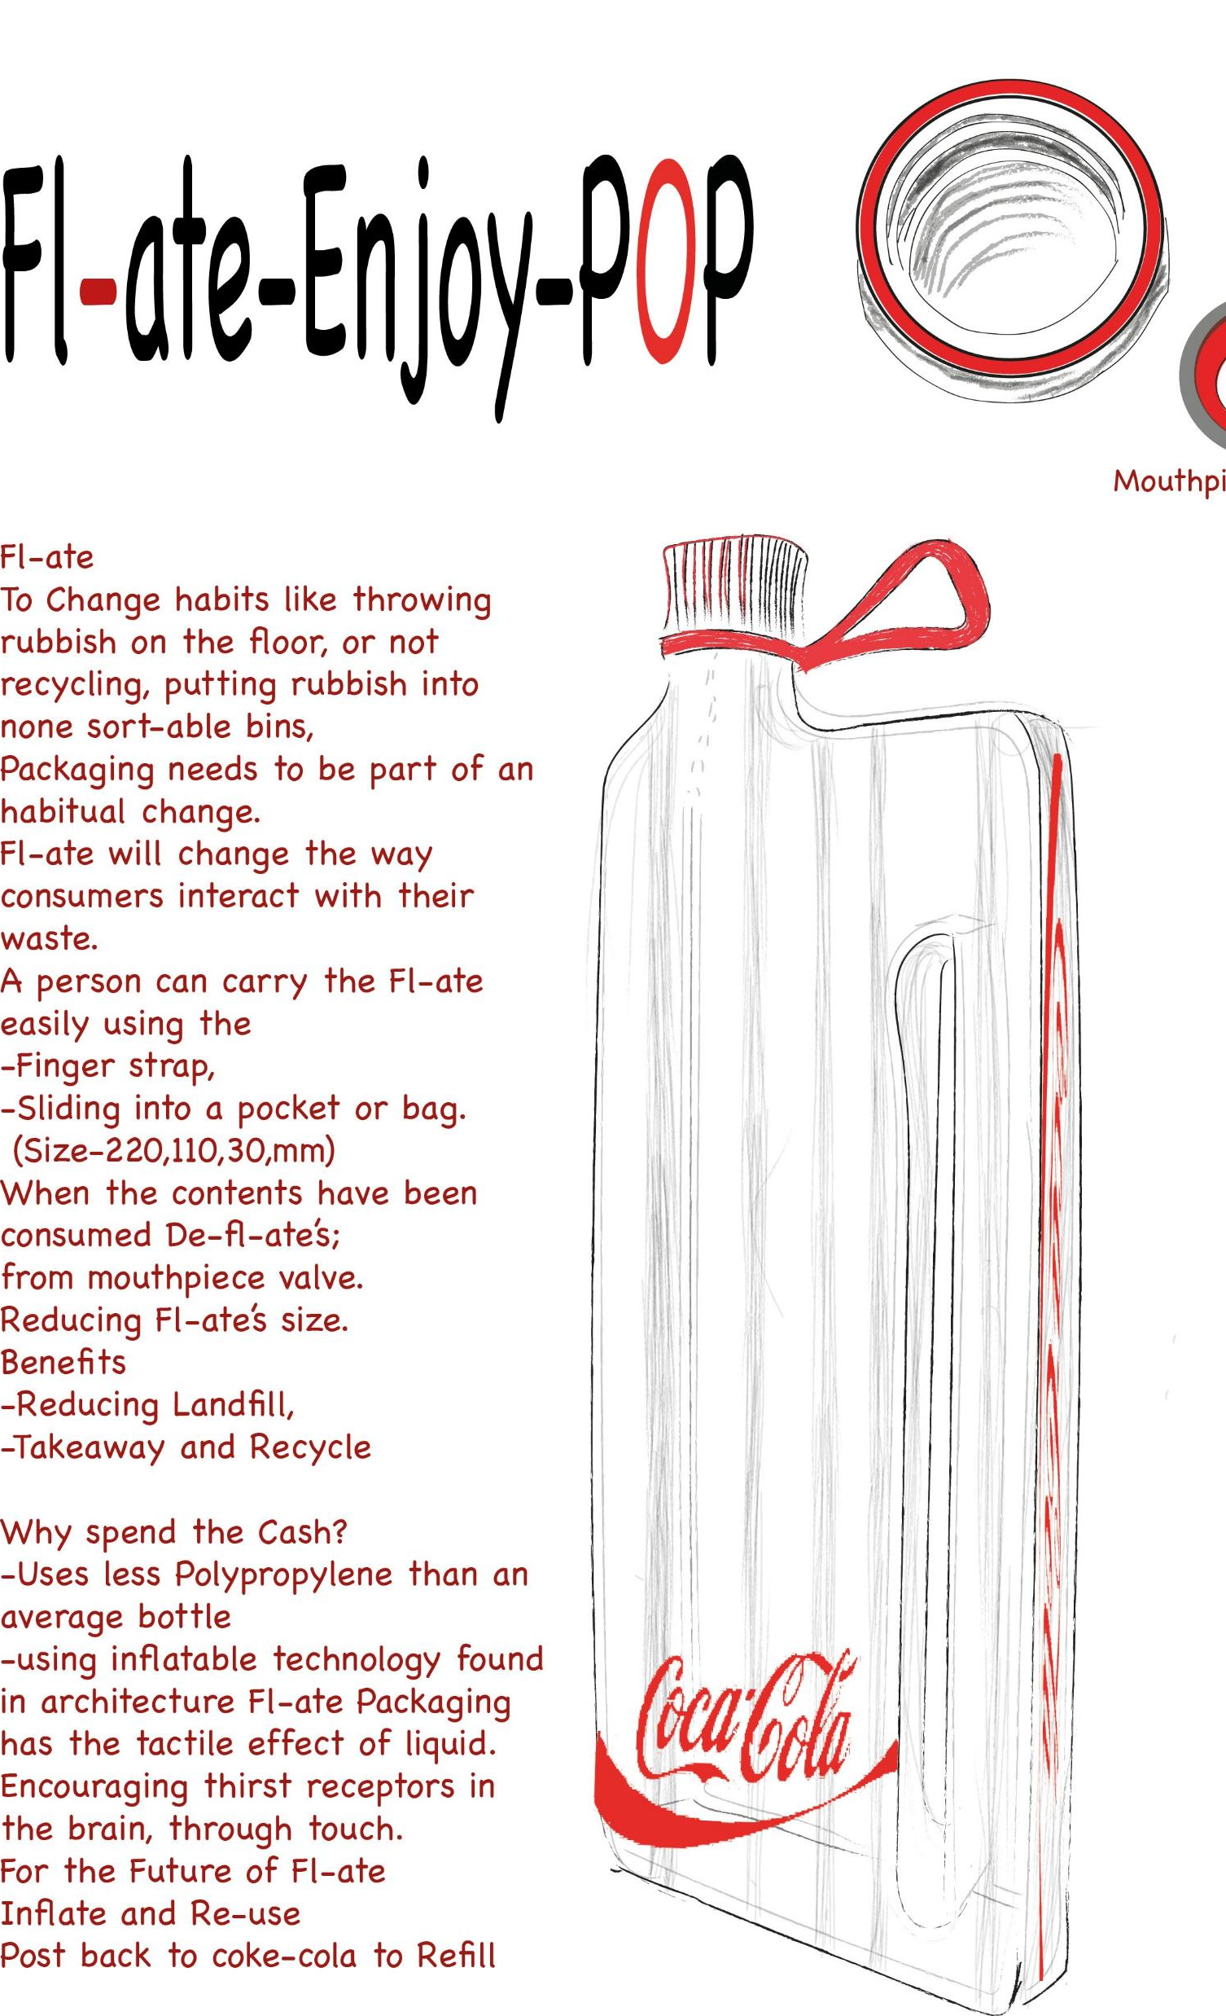
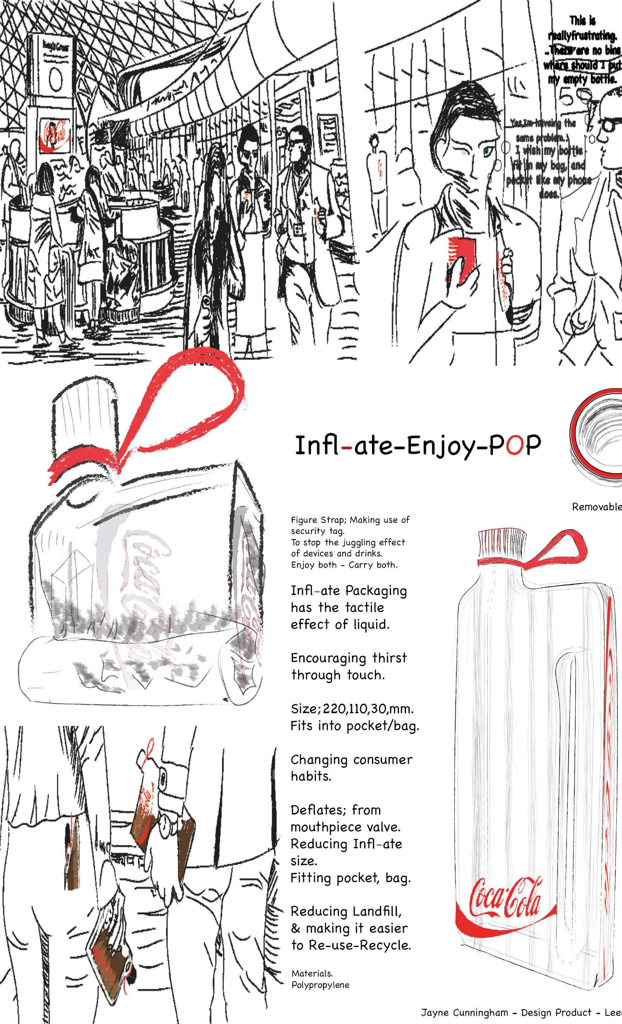
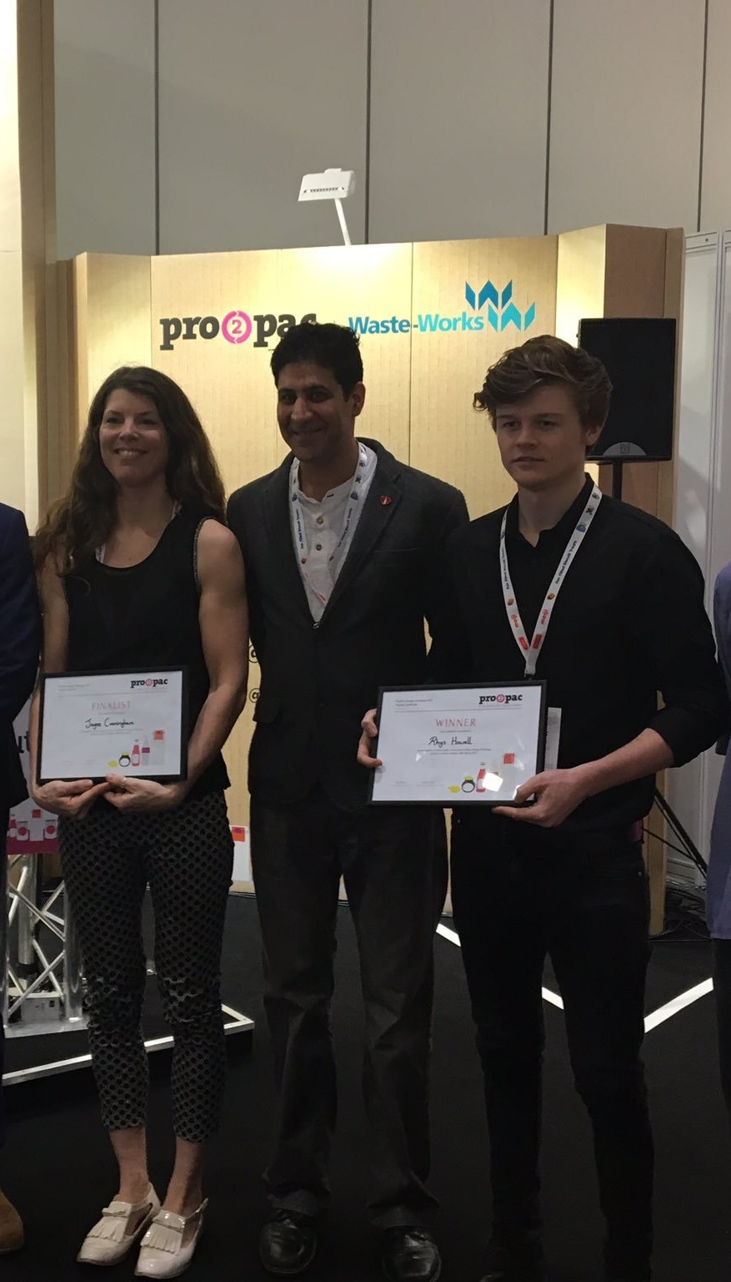

Slide 8

The Challenge:
Design a packaging product with a system that works towards solving global issues…
Littering on land and below water
Depleted nutrients in agricultural soils
Improves human health

Slide 9
This Photo by Unknown Author is licensed under CC BY-NC-ND
Global Littering
This Photo by Unknown Author is licensed under CC BY-NC-ND
This Photo by Unknown Author is licensed under CC BY-SA

Slide 10
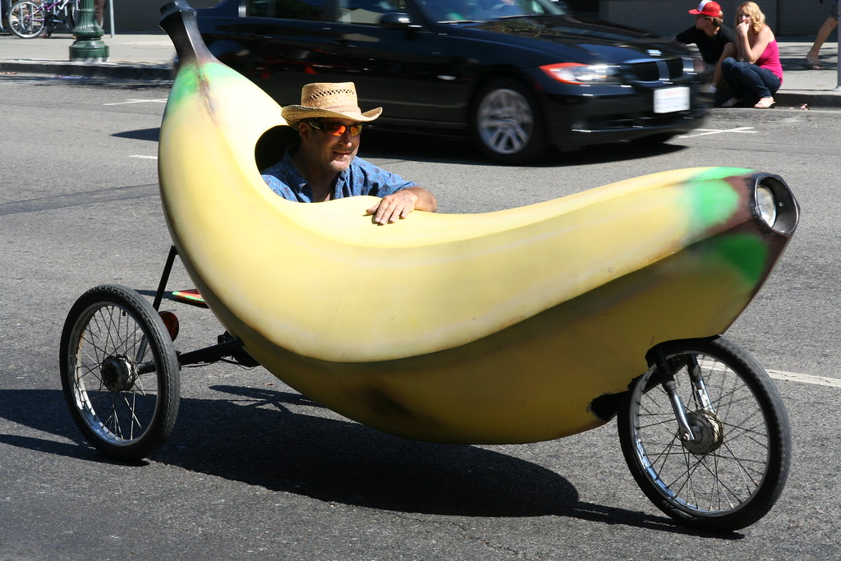
The Challenge:
Design a packaging product with a system that works towards solving global issues…
Littering on land and below water
Depleted nutrients in agricultural soils
Improves human health
This Photo by Unknown Author is licensed under CC BY-SA-NC

Slide 11
The Challenge:
Design a packaging product with a system that works towards solving global issues…
Littering on land and below water
Depleted nutrients in agricultural soils
Improves human health

Slide 12
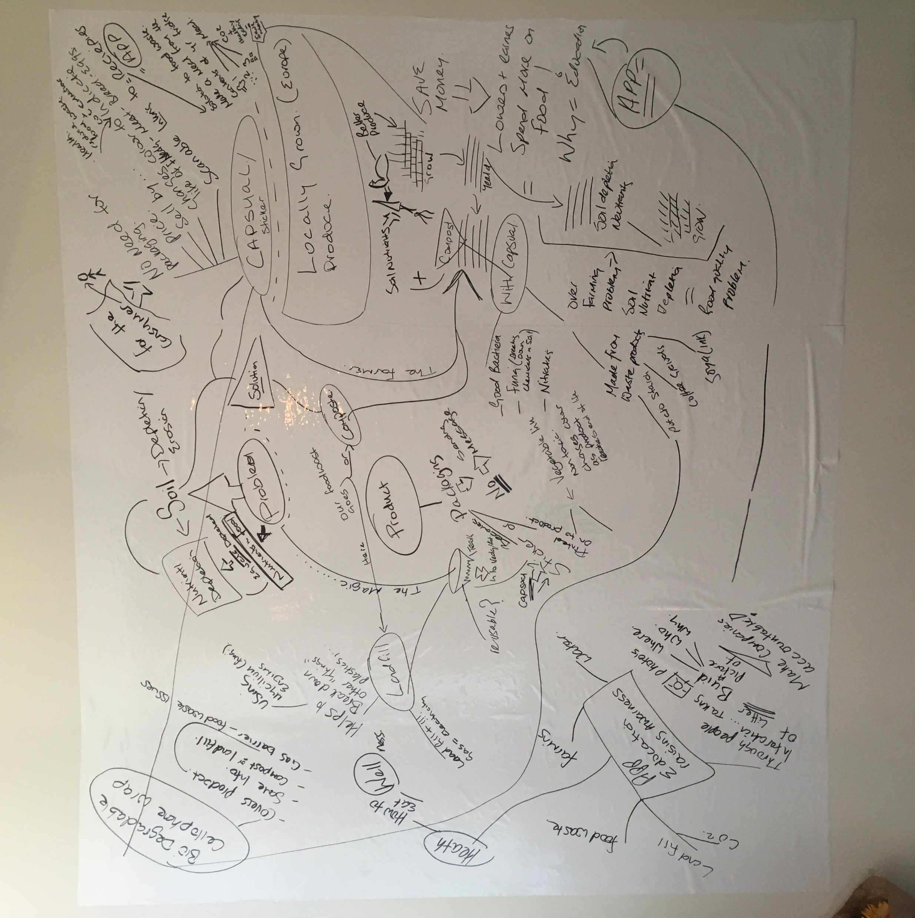
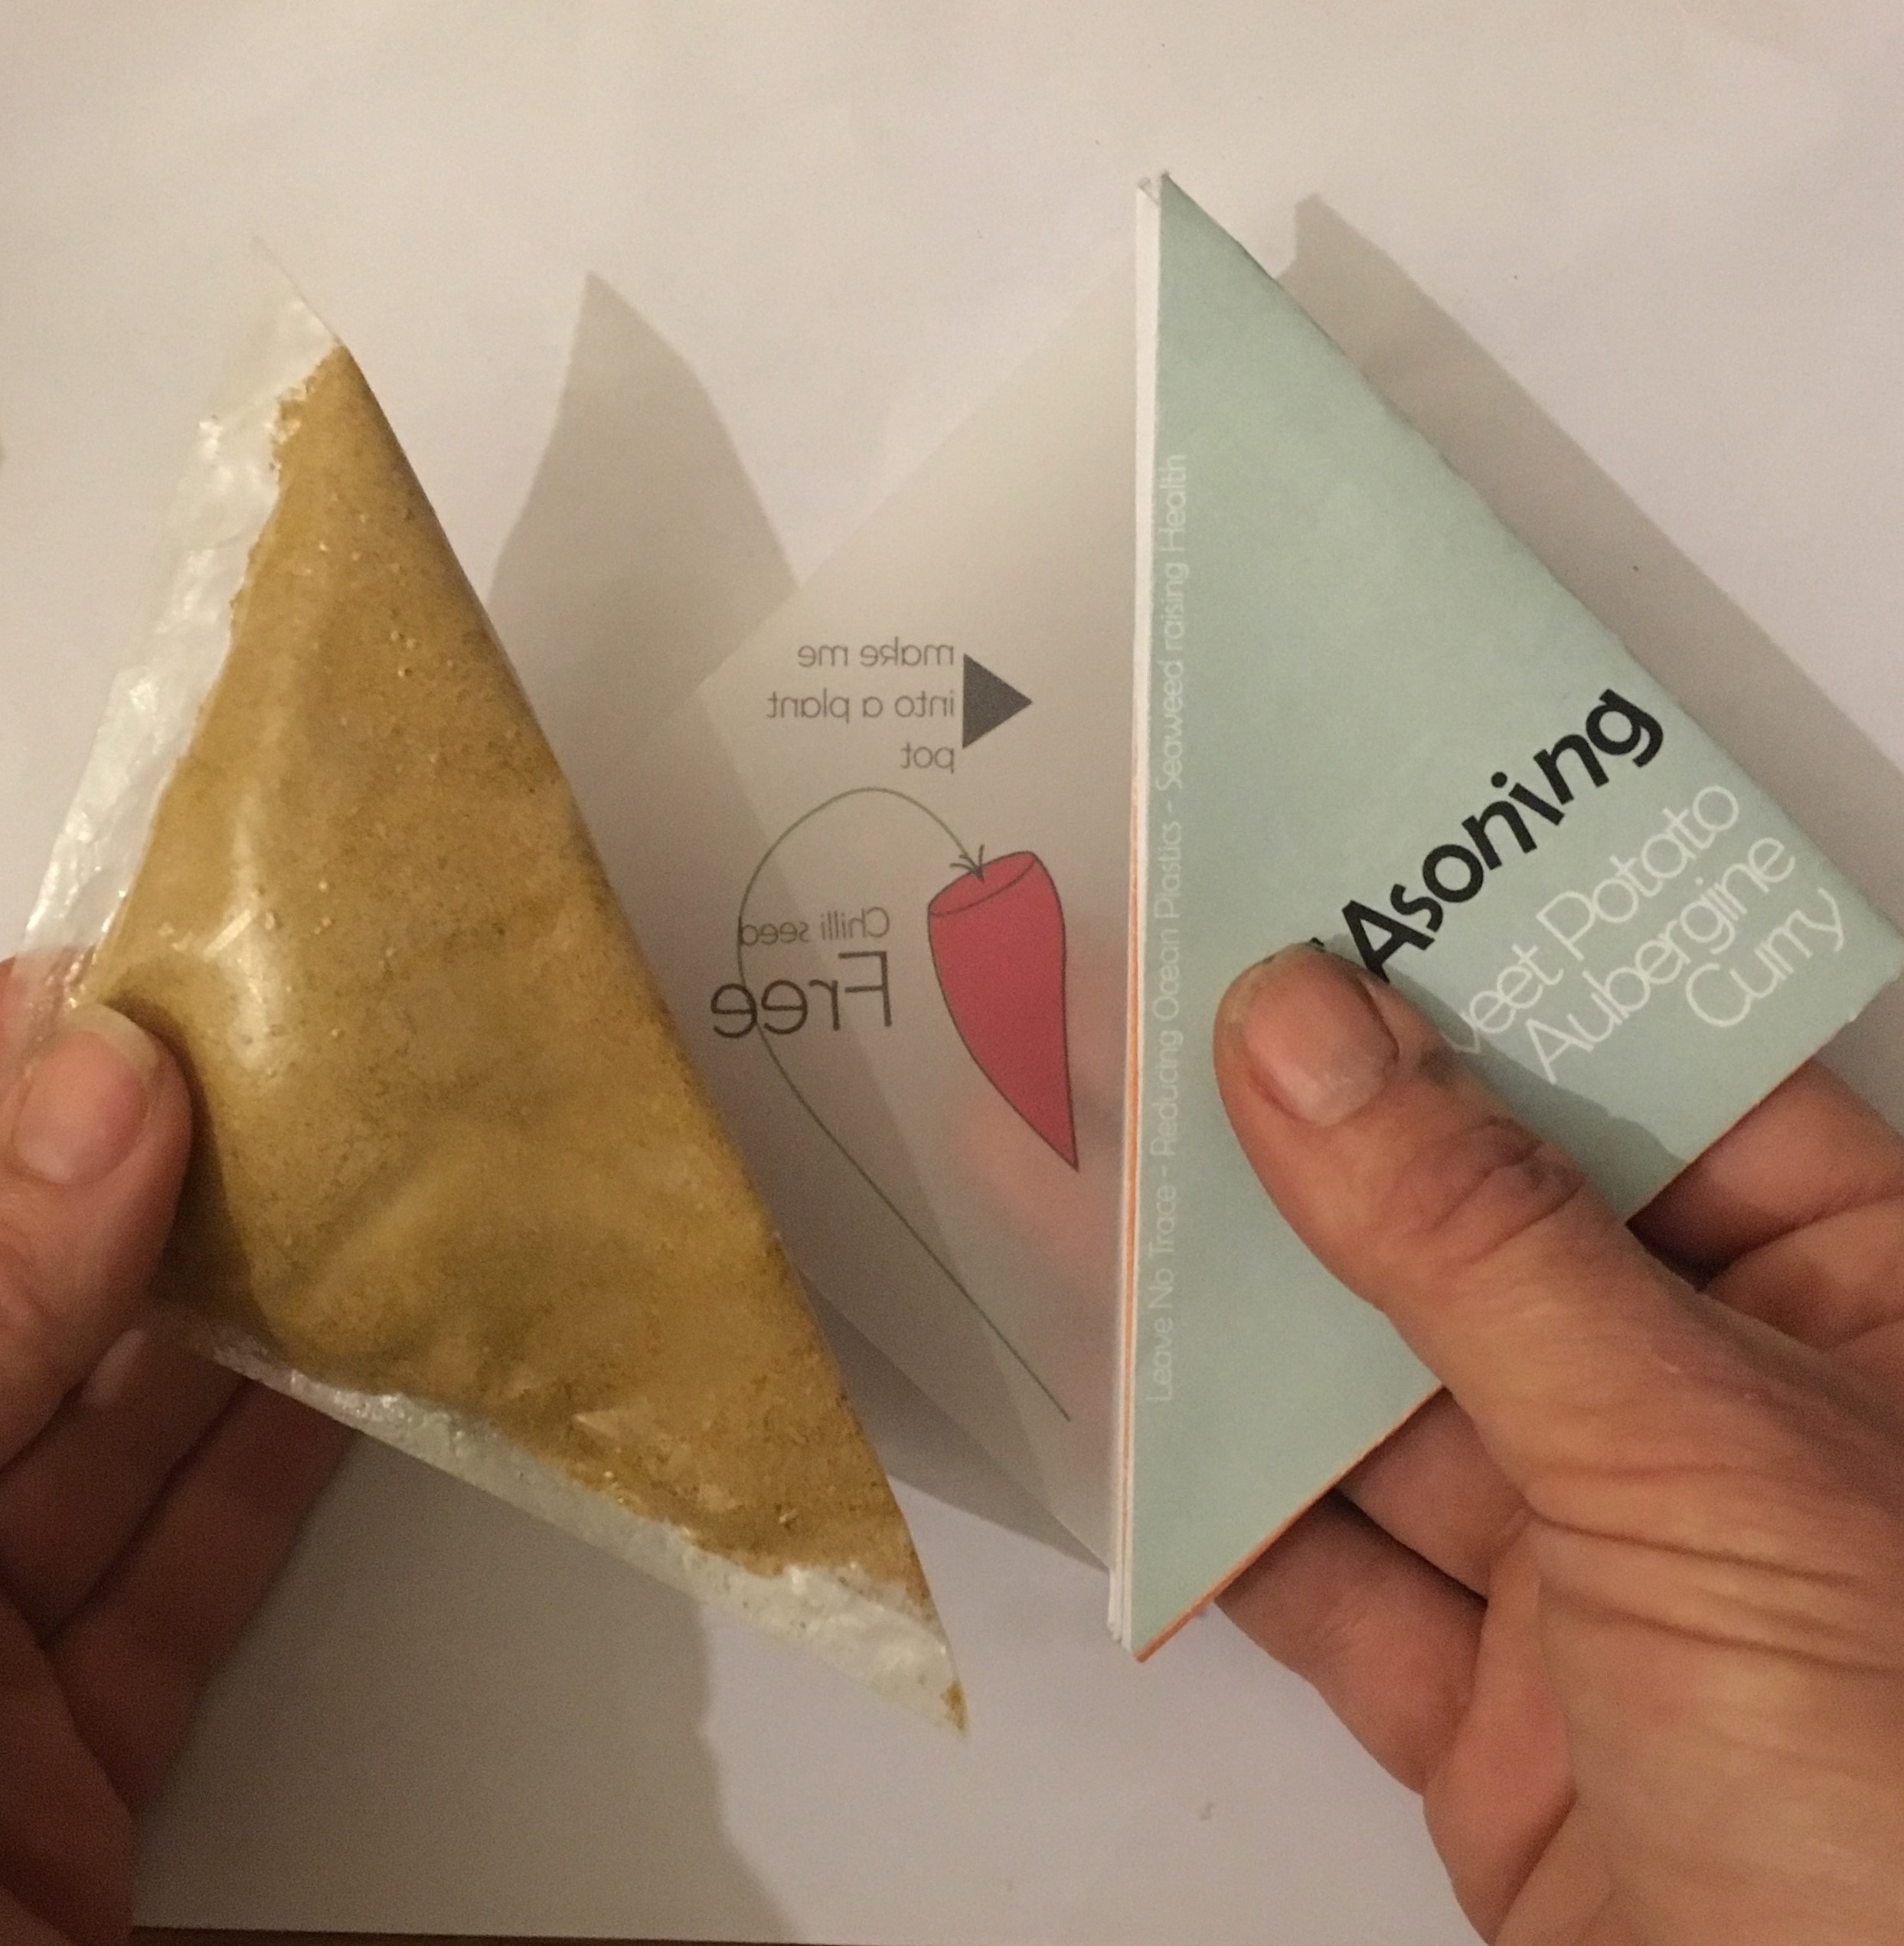
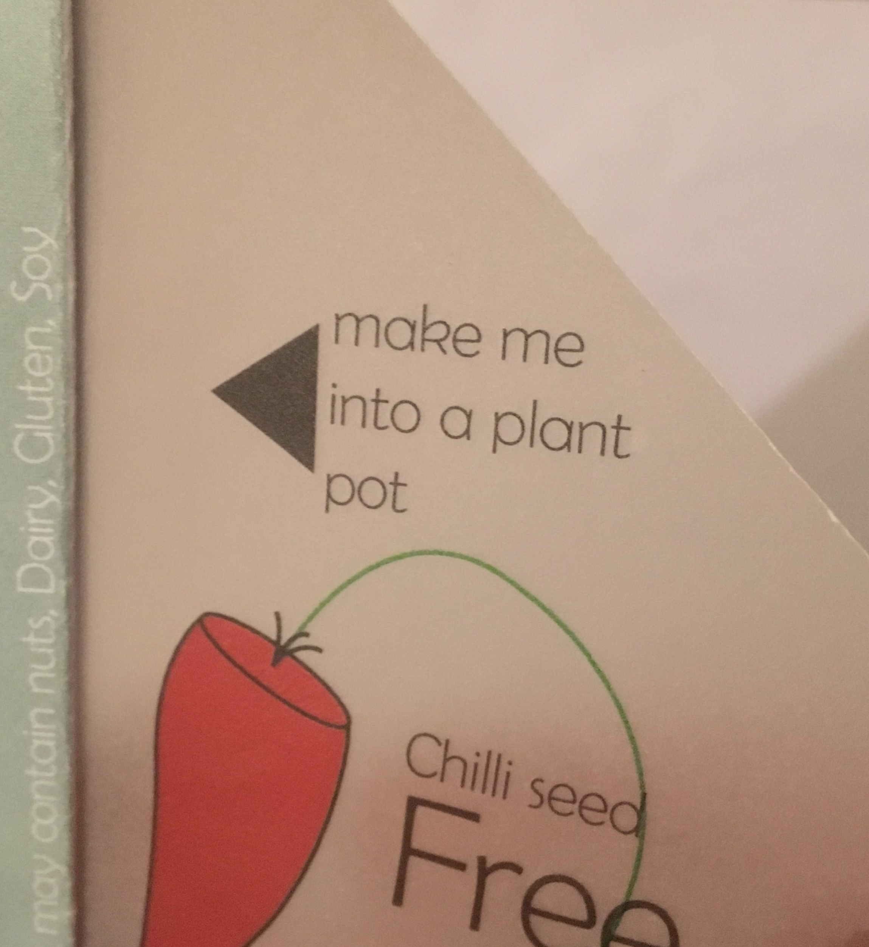
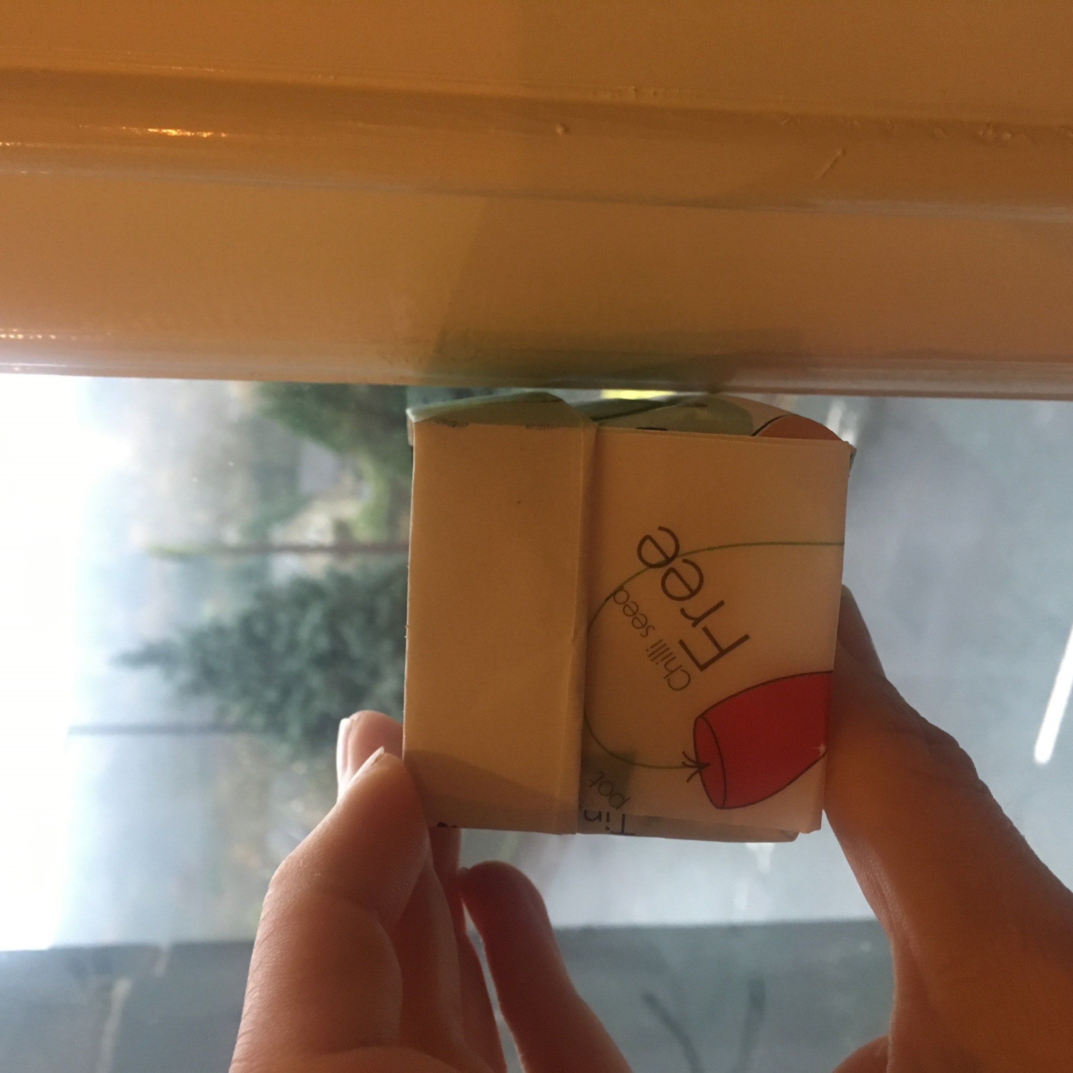
From these ideas
To this edible packaging and meal concept

Slide 13
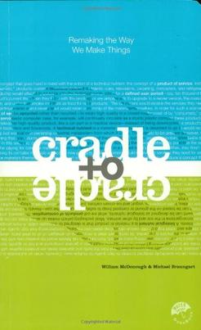
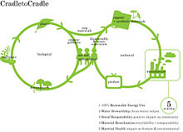
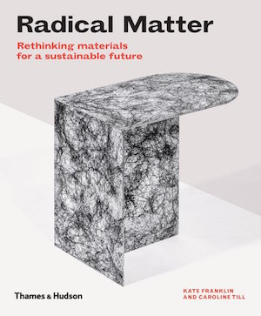
Summary of the C2C approach:
“Rather than seeing materials as a waste management problem, as in the
cradle-to-grave system, cradle-to-cradle design is based on the closed-loop nutrient cycles of nature, in which there is no waste. Just like nature, the cradle-to-cradle design seeks, from the start, to create buildings, communities and systems that generate wholly positive effects on human and environmental health.
Cradle 2 Cradle
Waste = Food
Not less waste and fewer negative effects, but more positive effects of regeneration, seed, growth, plant, product, “upcycle” and/or seed, growth, plant, product etc etc. One organism’s waste is food for another, and nutrients and energy flow perpetually in closed-loop cycles of growth, decay and rebirth. Waste equals food.

Slide 14
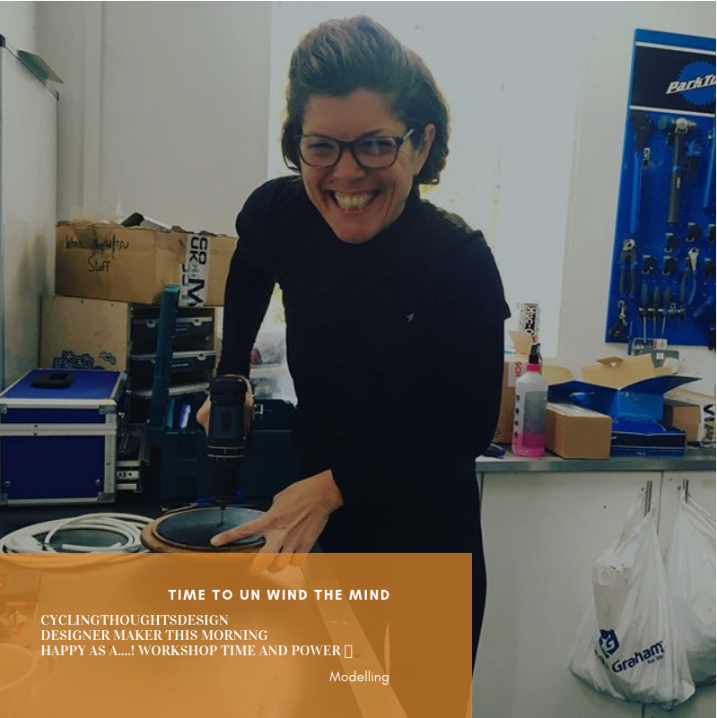
Blogging –
My way of writing the dreaded dissertation
https://feet1stblog.wordpress.com/2019/01/10/
This way of recording meant that I could link my Instagram social media, which I use as a time line to record photos of me researching –
Thinking thorough making.
Thinking through making
Professor Tim Ingold,
University of Aberdeen, Scotland
https://www.youtube.com/_{watch}?v=Ygne72-4zyo

Slide 15
The Challenge:
Design food packaging solution and system that works towards solving the global issues…
Littering on land and below water
Depleted nutrients in agricultural soils
Improves human health

Slide 16
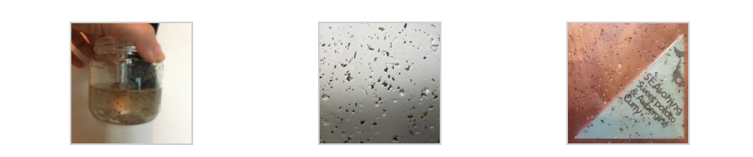
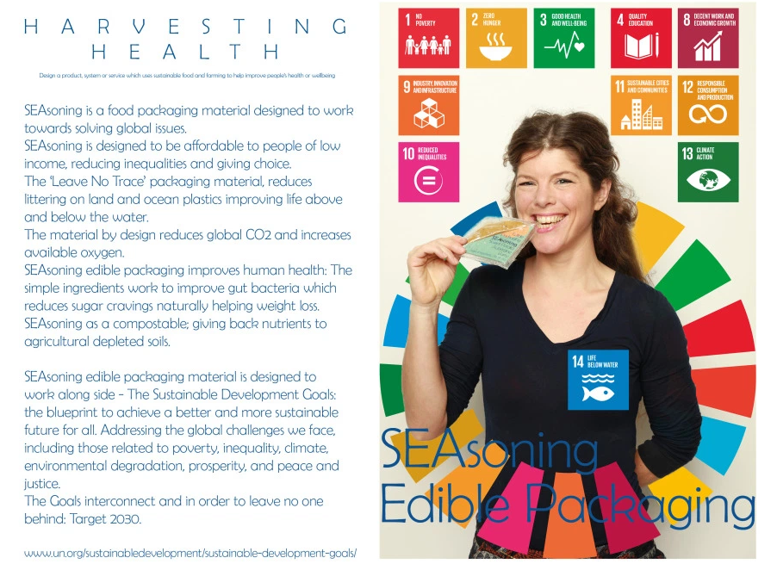
Liquid polymer
Transparent
Dried into a flat surface

Slide 17
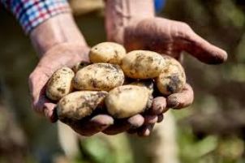
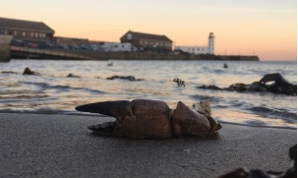
The ingredients, potato starch and seaweed makes the ‘Leave No Trace’ transparent material.
I chose these materials because they were free, and for their added value to human heath.

Slide 18
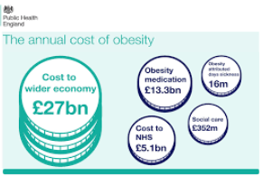
Improving human health reduces the NHS bill caused by diabetes and obesity. A whopping 16 bn a year in the U.K.

Slide 19
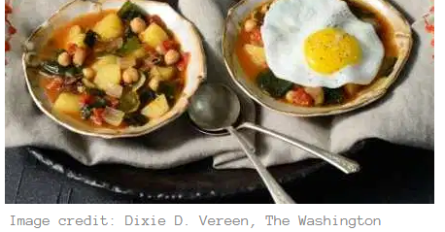

Slide 20
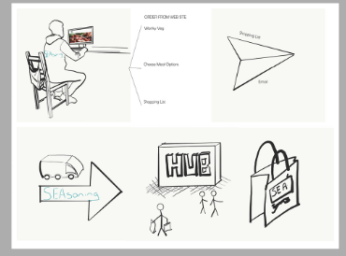

Partnership

Slide 21
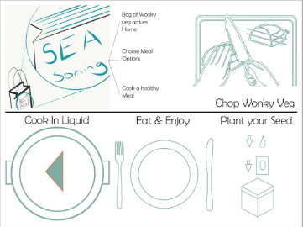
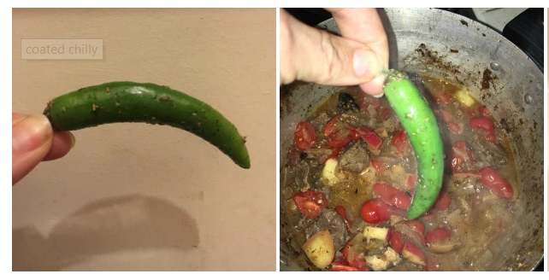
Naturally preserves vegetables and fruit,
Designed to taste great, hence the name SEAsoning.

Slide 22
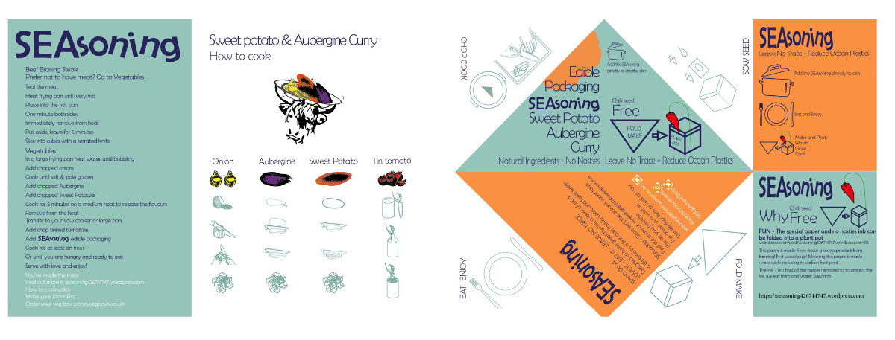
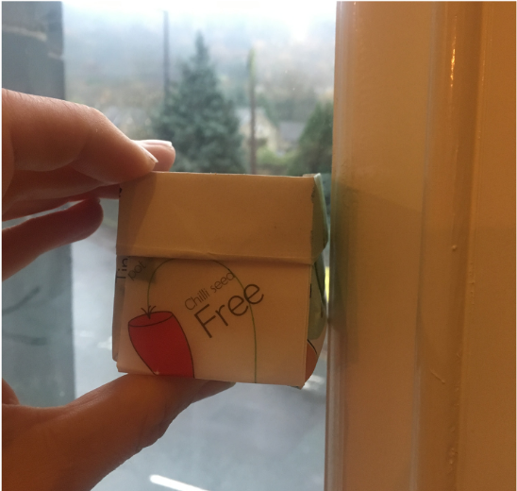
Education Through Play

Slide 23
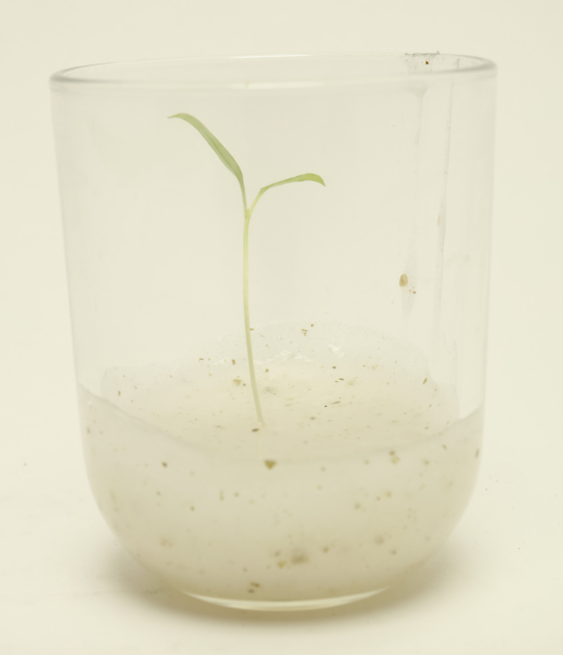
Leave No Trace Packaging solution
SEAsoning material is manufactured from organic nutritious materials and was developed to be home compostable and anaerobically digestible.
The waste from these processes gives back nutrients to agricultural depleted soils, caused by over farming, returning the soil to health, and therefore being part of a solution for depleted nutrients, replacing lost nutrients in agricultural soil improves human health symbiotically.

Slide 24
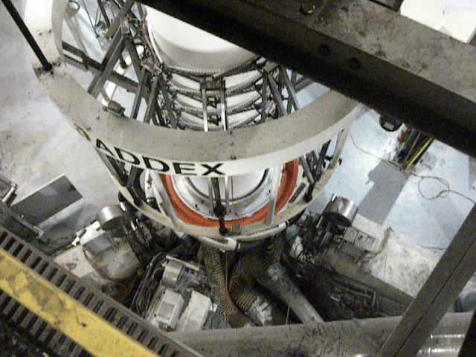
Manufacturing
My intention for the material is to be extruded, then blow-moulded into shape, like current plastics on the assembly line, or to be made into flat surface sheets using similar methods to that of making pasta sheets.
This Photo by Unknown Author is licensed under CC BY

Slide 25
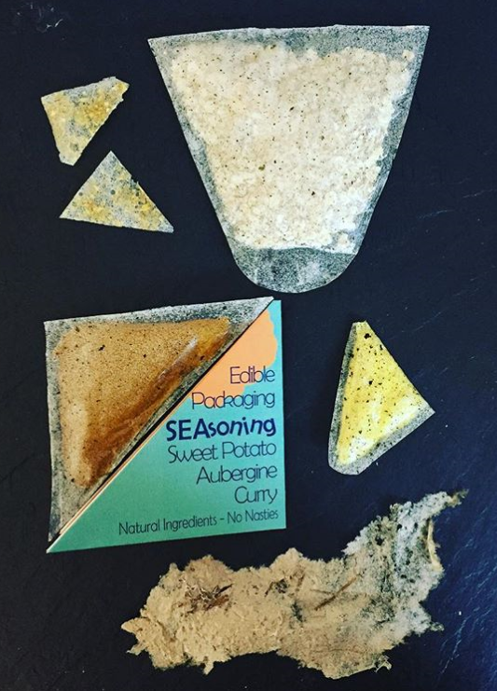
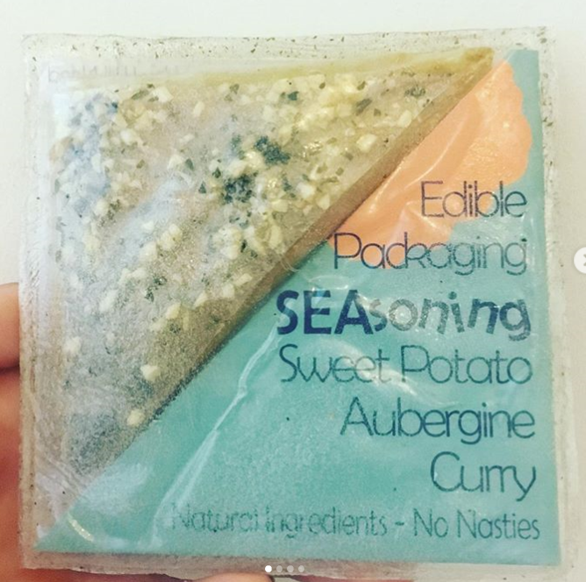
Application for food packaging
https://www.instagram.com/p/BxNFQRYlFdQ/?igshid=18djfim79bit
https://www.instagram.com/p/BrxD_IiFscU/?igshid=1e97mgwsuj874

Slide 26
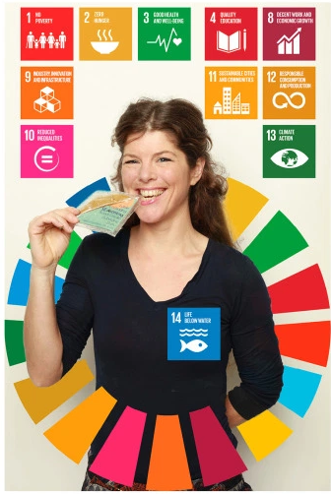
The added Value.
SEAsoning edible packaging material is designed to work alongside – The Sustainable Development Goals: The blueprint to achieve a better and more sustainable future for all. Addressing the global challenges we face, including those related to poverty, inequality, climate, environmental degradation, prosperity, and peace and justice.
The Goals interconnect and in order to leave no one behind: Target 2030.

Slide 27
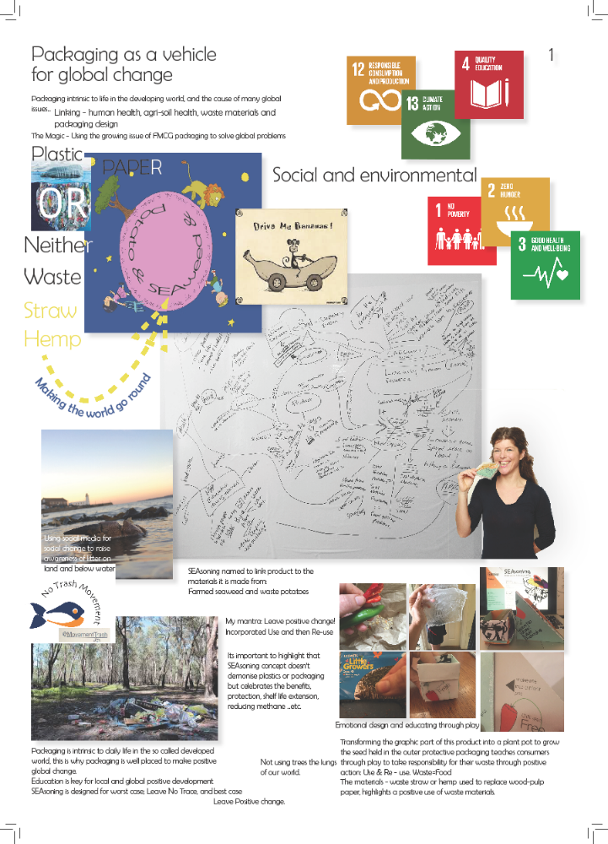
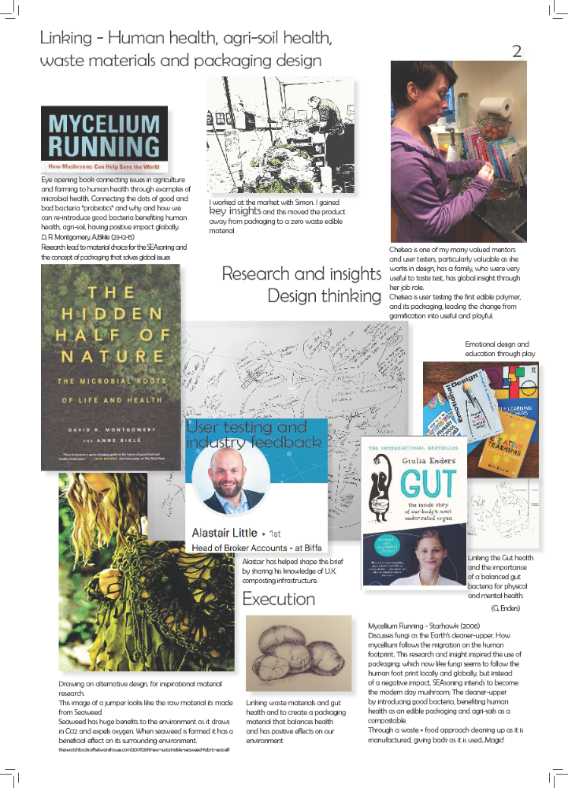
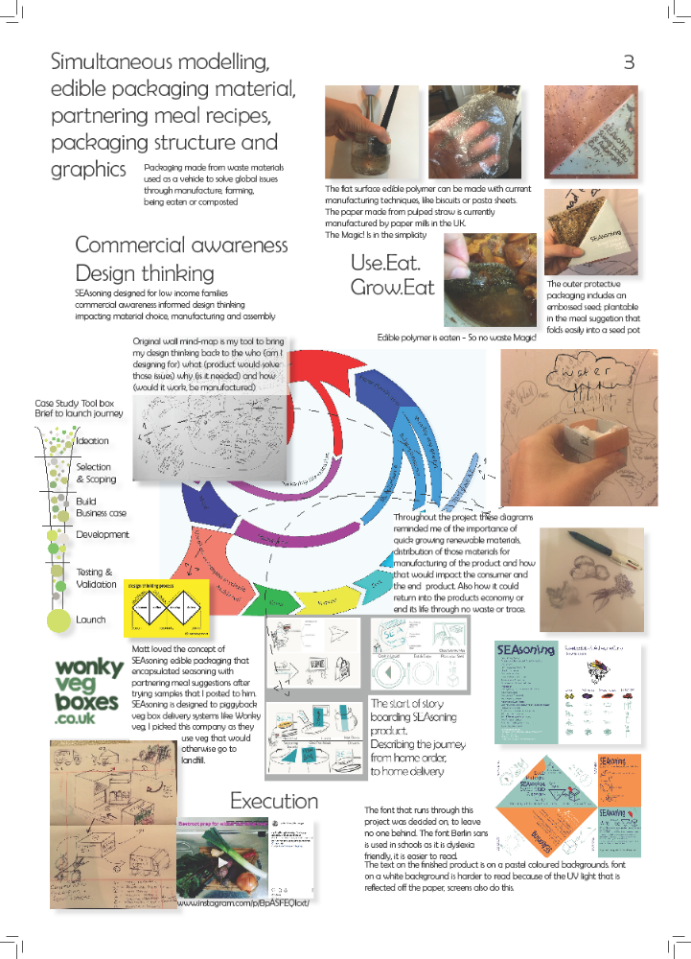
https://feet1stblog._{wordpress}.com/2019/01/10/__trashed/

Slide 28
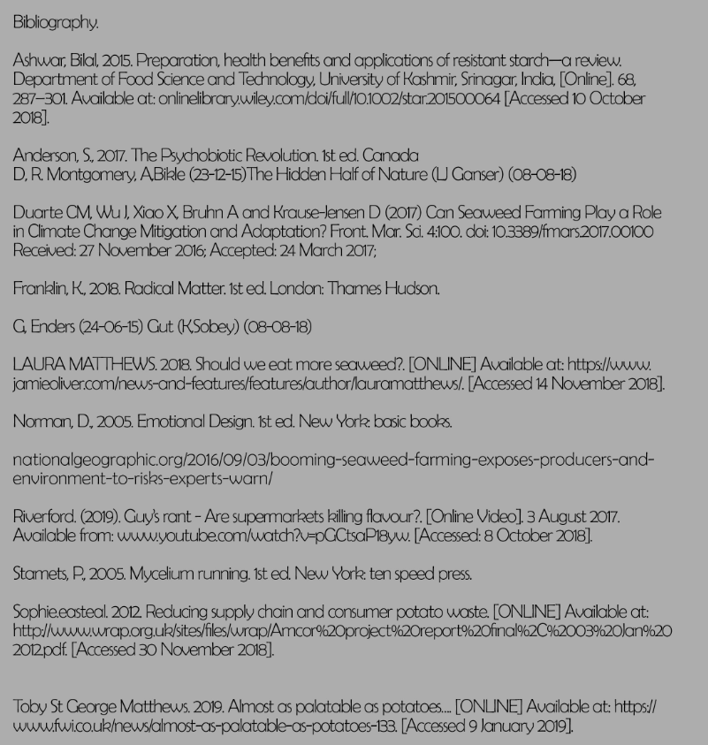
https://www.instagram.com/p/BrXGvgTFZ-W/?igshid=6g0msfz7pqh8
https://www.instagram.com/p/BrXGo0VF2Bb/?igshid=dhn71dtu28ke
https://www.instagram.com/p/BrXGvgTFZ-W/?igshid=1ss8hlyz5zqq
Https://YouTube.be/cvphoQGjNyc
https://www.instagram.com/p/BqXAQ9IFC8r/?igshid=sk69i53z2n4
https://www.instagram.com/p/BpASFEQlcxt/?igshid=fyi1de6vddm8

